Slide 1
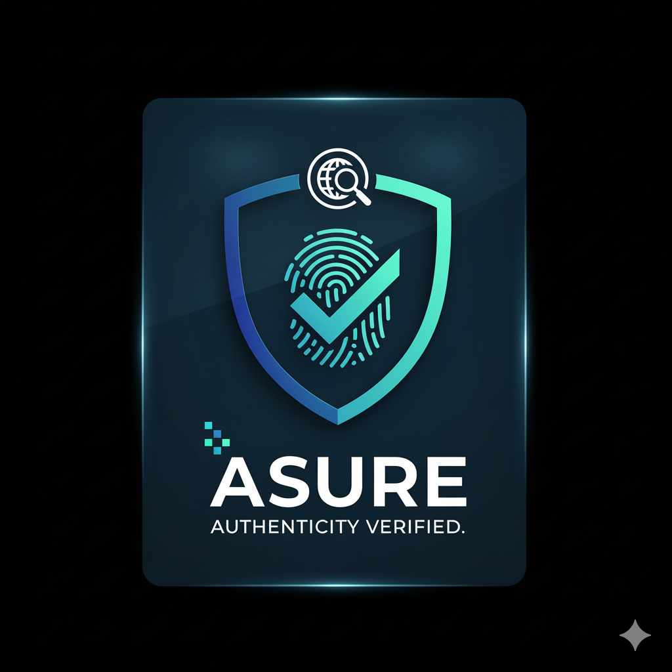
Asure
Group: 04
Mohammad Zonayet Hassan Polok (2031267642)
Ahnaf Akib Ahmed (2312304642)
Tasmia Rashed Ramisha (2312131042)
Sumya akter(2111913642)
CSE299
SECTION:04

Slide 2

The Need for Innovation
Addressing the Challenges of Digital Credential Verification Systems
Asure recognizes the urgent need for a comprehensive solution to combat the rise of fake credentials and inadequate learning recommendations. Current systems fall short, addressing only parts of the problem. With our dual focus on AI Verification and High-Trust Learning, we aim to create a more reliable and effective integrated platform.

Slide 3
Digital Trust Comparison
Existing Solutions vs. Asure’s Innovation
CertiCheck Vulnerabilities
MediGuard Limitations
Asure’s Double-Check
CertiCheck relies on basic database lookups, making it vulnerable to visual fraud, as it cannot effectively validate credentials beyond superficial checks.
MediGuard employs a rule-based approach, which is inflexible to complex fraud types and fails to adapt to evolving methods used by fraudsters in credential verification.
Asure’s innovative Double-Check System combines rapid database validation with advanced AI image analysis, effectively preventing sophisticated visual fraud through thorough authenticity scoring and tampering detection.

Slide 4

Project Progress
Overview of Key Developments in Phase 1 Implementation
In the initial phase of the Asure project, we successfully implemented multi-role authentication, ensuring secure access for various stakeholders. The integration of MongoDB has provided a robust backing for our verification data, while the frontend and backend setups have been completed using React and Express. All core verification pages are now functional and stable.

Slide 5


Gemini AI Integration Readiness
Overview of AI Endpoints and their capabilities
The backend is now fully prepared for Gemini AI deployment, featuring advanced endpoints for medicine AI suggestions and certificate analysis, enhancing our verification processes significantly.

Slide 6

Summary & Key Takeaways
Asure's Unique Value Proposition in AI-Powered Learning and Verification
Asure uniquely combines AI verification with high-trust personalized learning. By addressing both authenticity and skill personalization, it significantly outperforms competitors. The system stands ready for AI integration and market deployment, ensuring a more robust and reliable approach to digital credentialing and learning pathways.

Slide 7
Thank you
-Asure

